Slide 1
Simulation and Modeling
Lecture 11
Random Number Generation
Muhammad Mahbub Alam
Professor
CSE Department, IUT

Slide 2
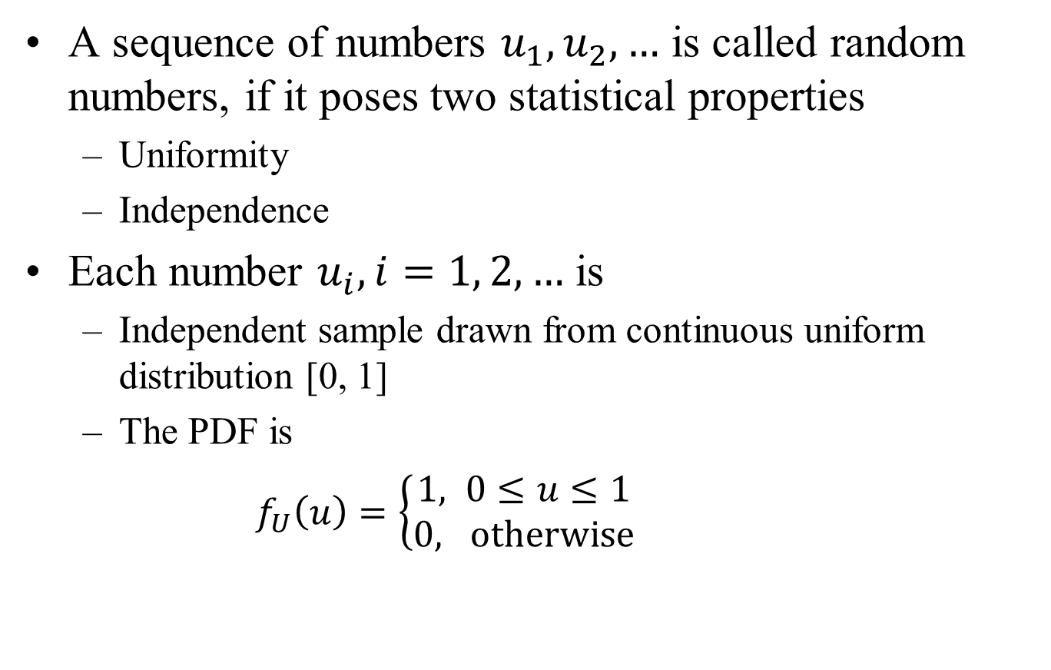
Random Numbers (1/2)
A sequence of numbers $u_{1}, u_{2}, …$ is called random numbers, if it poses two statistical properties
Uniformity
Independence
Each number $u_{i}, i=1, 2, …$ is
Independent sample drawn from continuous uniform distribution [0, 1]
The PDF is
$$f_{U}\left(u\right)=\left\{\begin{aligned}1, 0≤u≤1 \\ &0, otherwise\end{aligned}\right.$$

Slide 3
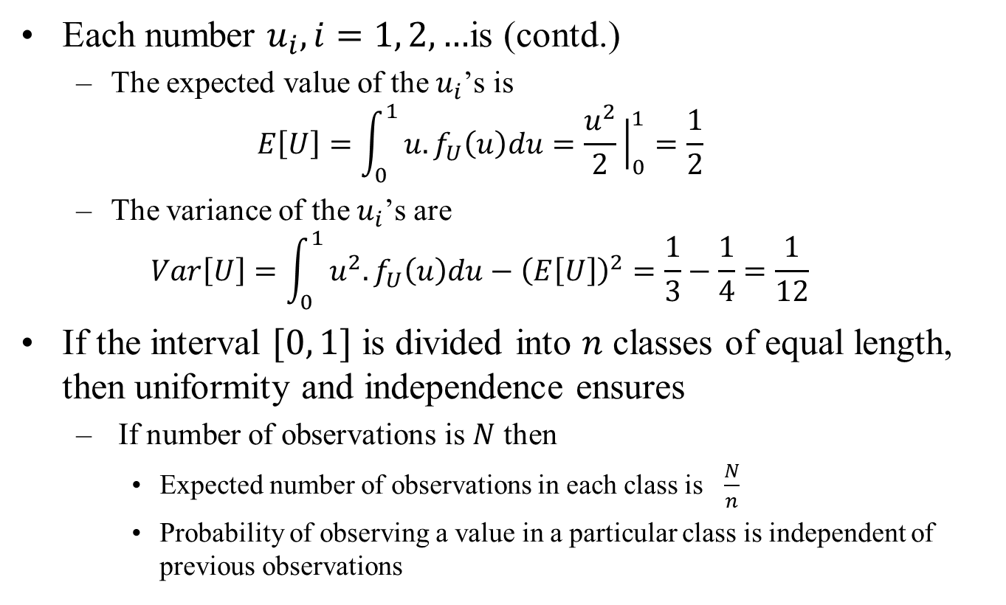
Random Numbers (2/2)
Each number $u_{i}, i=1, 2, …$is (contd.)
The expected value of the $u_{i}$’s is
$$E\left[U\right]=\int_{0}^{1}{u.f_{U}\left(u\right)du=\frac{u^{2}}{2}{\left.​\right|}_{0}^{1}}=\frac{1}{2}$$
The variance of the $u_{i}$’s are
$$Var\left[U\right]=\int_{0}^{1}{u^{2}.f_{U}\left(u\right)du−{\left(E\left[U\right]\right)}^{2}=\frac{1}{3}−\frac{1}{4}=\frac{1}{12}}$$
If the interval $[0, 1]$ is divided into $n$ classes of equal length, then uniformity and independence ensures
If number of observations is $N$ then
Expected number of observations in each class is $\frac{N}{n}$
Probability of observing a value in a particular class is independent of previous observations

Slide 4
Pseudo-Random Numbers
Random numbers generated by known methods
Numbers can be replicated
Numbers are not truly random
Pseudo-random number
Random numbers generated by computer programs / arithmetic methods
Pseudo-random numbers departs from ideal randomness, e.g.,
May not be uniformly distributed
May be discrete valued
Instead of continuous valued
The mean may too high or too low
The variance may be too high or too low
There may be dependence
Autocorrelation between numbers
Numbers successively higher/lower than adjacent numbers
Several numbers above the mean followed by several numbers below the mean

Slide 5
Pseudo-Random Numbers - Considerations
Methods used for generating random numbers should be
Fast, i.e., computationally and storage efficient
Portable to different computers, or even to different programming languages
With sufficiently long cycle
Length of a sequence before the numbers repeat
Able to replicate the random numbers
Able to generate separate streams
Able to approximate the statistical properties of random numbers
Uniformity
Independence
Maximum density

Slide 6
Random-Number Generations

Slide 7
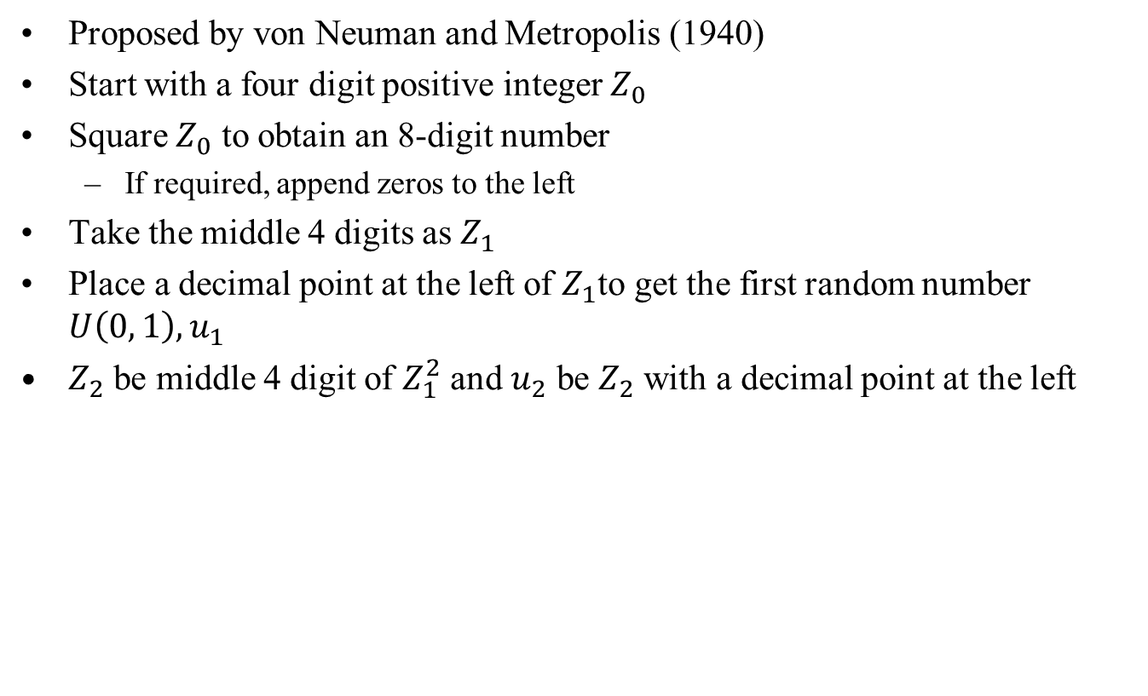
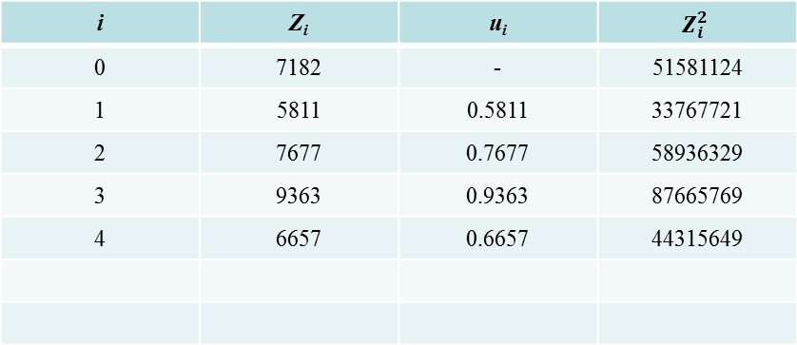
Midsquare Method (1/2)
Proposed by von Neuman and Metropolis (1940)
Start with a four digit positive integer $Z_{0}$
Square $Z_{0}$ to obtain an 8-digit number
If required, append zeros to the left
Take the middle 4 digits as $Z_{1}$
Place a decimal point at the left of $Z_{1}$to get the first random number $U\left(0, 1\right), u_{1}$
$Z_{2}$ be middle 4 digit of $Z_{1}^{2}$ and $u_{2}$ be $Z_{2}$ with a decimal point at the left
i | Z_{i} | u_{i} | $$Z_{i}^{2}$$
0 | 7182 | - | 51581124
1 | 5811 | 0.5811 | 33767721
2 | 7677 | 0.7677 | 58936329
3 | 9363 | 0.9363 | 87665769
4 | 6657 | 0.6657 | 44315649

Slide 8
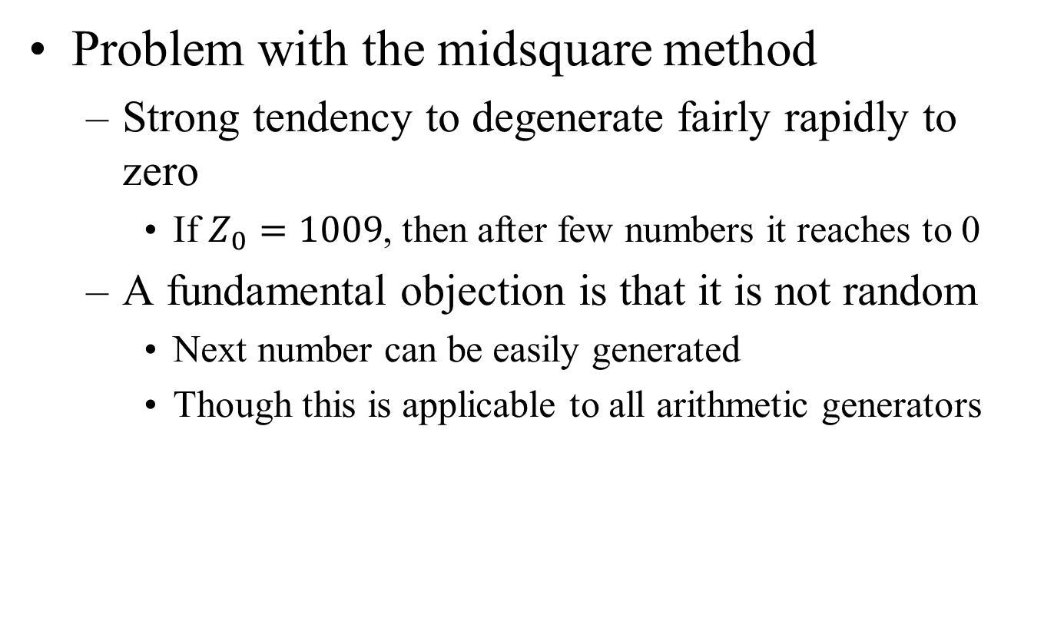
Midsquare Method (2/2)
Problem with the midsquare method
Strong tendency to degenerate fairly rapidly to zero
If $Z_{0}=1009$, then after few numbers it reaches to 0
A fundamental objection is that it is not random
Next number can be easily generated
Though this is applicable to all arithmetic generators

Slide 9
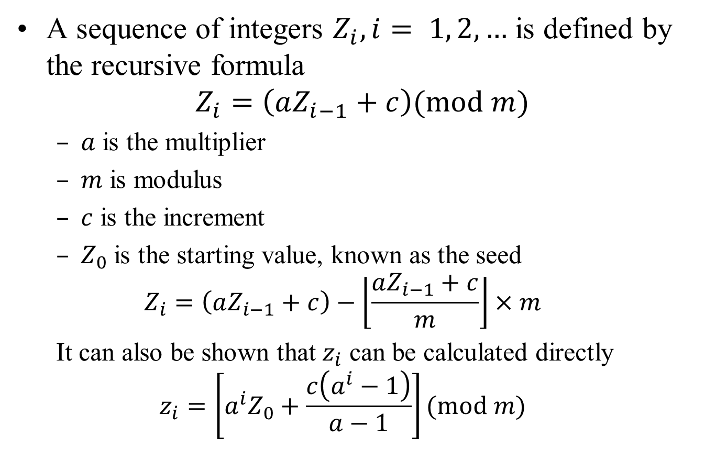
Linear Congruential Generators (LCG)
A sequence of integers $Z_{i}, i= 1, 2, …$ is defined by the recursive formula
$$Z_{i}=\left(aZ_{i−1}+c\right)(mod m)$$
$a$ is the multiplier
$m$ is modulus
$c$ is the increment
$Z_{0}$ is the starting value, known as the seed
$$Z_{i}=\left(aZ_{i−1}+c\right)−\left\lfloor \frac{aZ_{i−1}+c}{m}\right\rfloor ×m$$
It can also be shown that $z_{i}$ can be calculated directly
$$z_{i}=\left[a^{i}Z_{0}+\frac{c\left(a^{i}−1\right)}{a−1}\right](mod m)$$

Slide 10
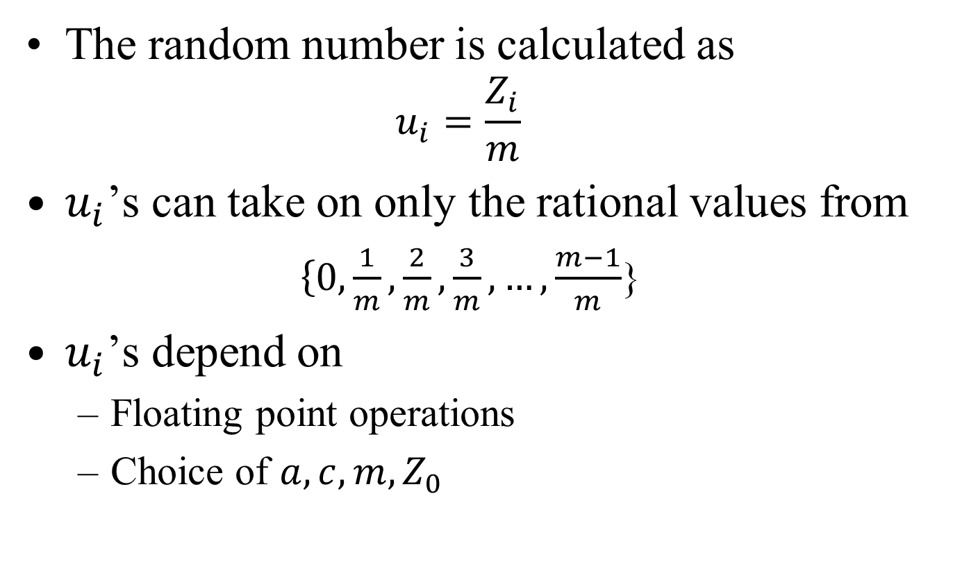
Linear Congruential Generators (LCG)
The random number is calculated as
$$u_{i}=\frac{Z_{i}}{m}$$
$u_{i}$’s can take on only the rational values from
$\left\{0\right.,\frac{1}{m},\frac{2}{m},\frac{3}{m}, …,\frac{m−1}{m}$}
$u_{i}$’s depend on
Floating point operations
Choice of $a, c, m, Z_{0}$

Slide 11
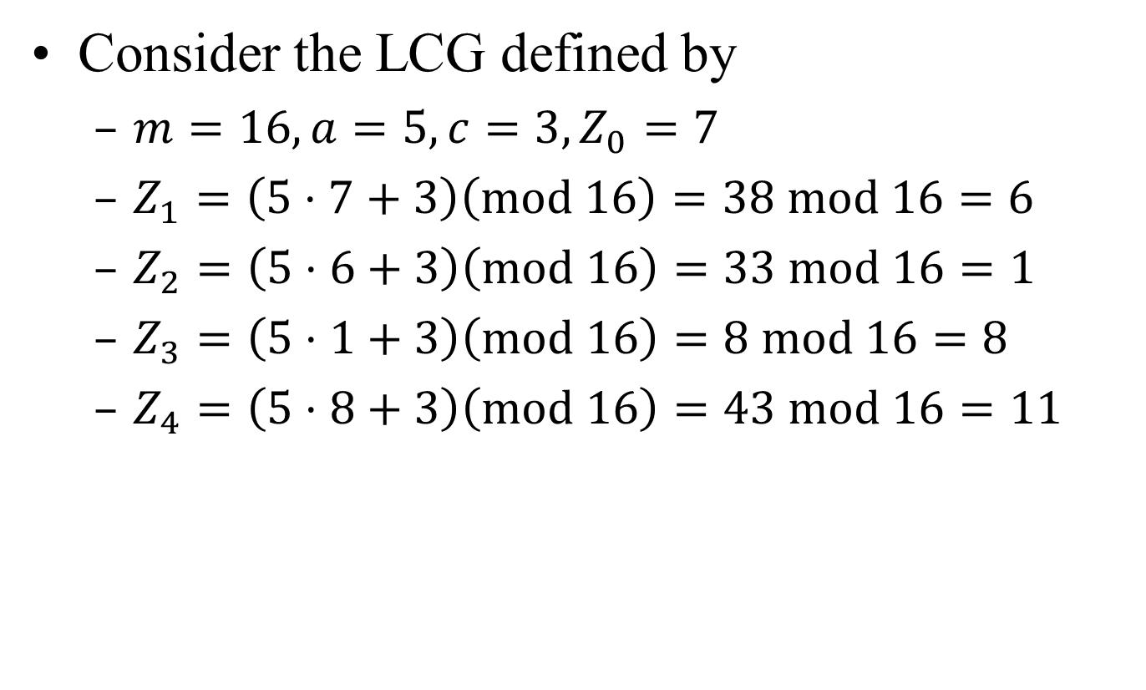
LCG – Example (1/2)
Consider the LCG defined by
$m=16, a=5, c=3, Z_{0}=7$
$Z_{1}=\left(5⋅7+3\right)\left(mod 16\right)=38 mod 16=6$
$Z_{2}=\left(5⋅6+3\right)\left(mod 16\right)=33 mod 16=1$
$Z_{3}=\left(5⋅1+3\right)\left(mod 16\right)=8 mod 16=8$
$Z_{4}=\left(5⋅8+3\right)\left(mod 16\right)=43 mod 16=11$

Slide 12
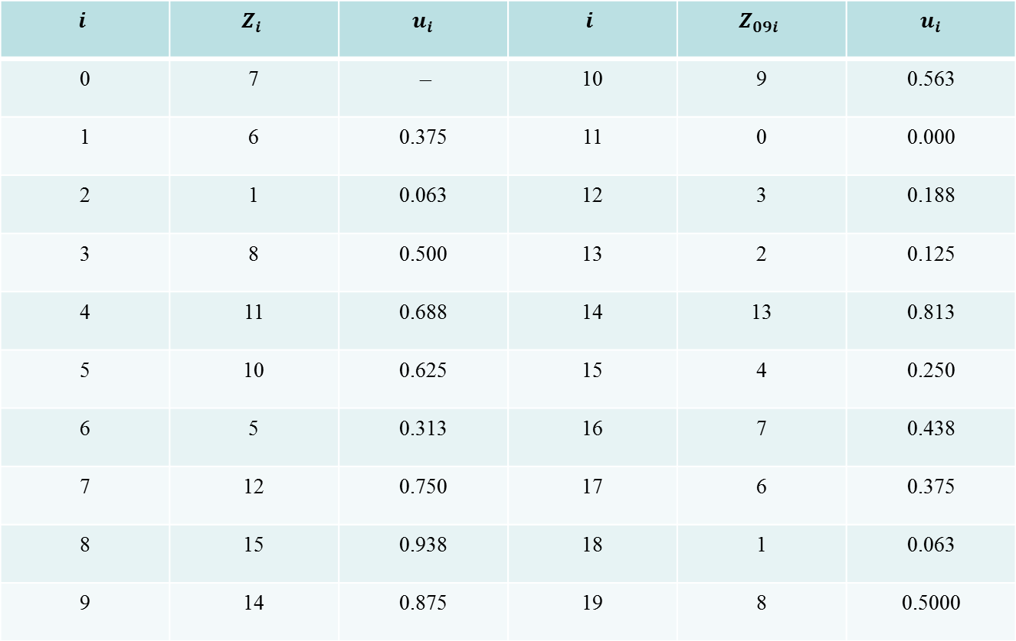
LCG – Example (2/2)
$$i$$ | $$Z_{i}$$ | $$u_{i}$$ | $$i$$ | $$Z_{09i}$$ | $$u_{i}$$
0 | 7 | – | 10 | 9 | 0.563
1 | 6 | 0.375 | 11 | 0 | 0.000
2 | 1 | 0.063 | 12 | 3 | 0.188
3 | 8 | 0.500 | 13 | 2 | 0.125
4 | 11 | 0.688 | 14 | 13 | 0.813
5 | 10 | 0.625 | 15 | 4 | 0.250
6 | 5 | 0.313 | 16 | 7 | 0.438
7 | 12 | 0.750 | 17 | 6 | 0.375
8 | 15 | 0.938 | 18 | 1 | 0.063
9 | 14 | 0.875 | 19 | 8 | 0.5000

Slide 13
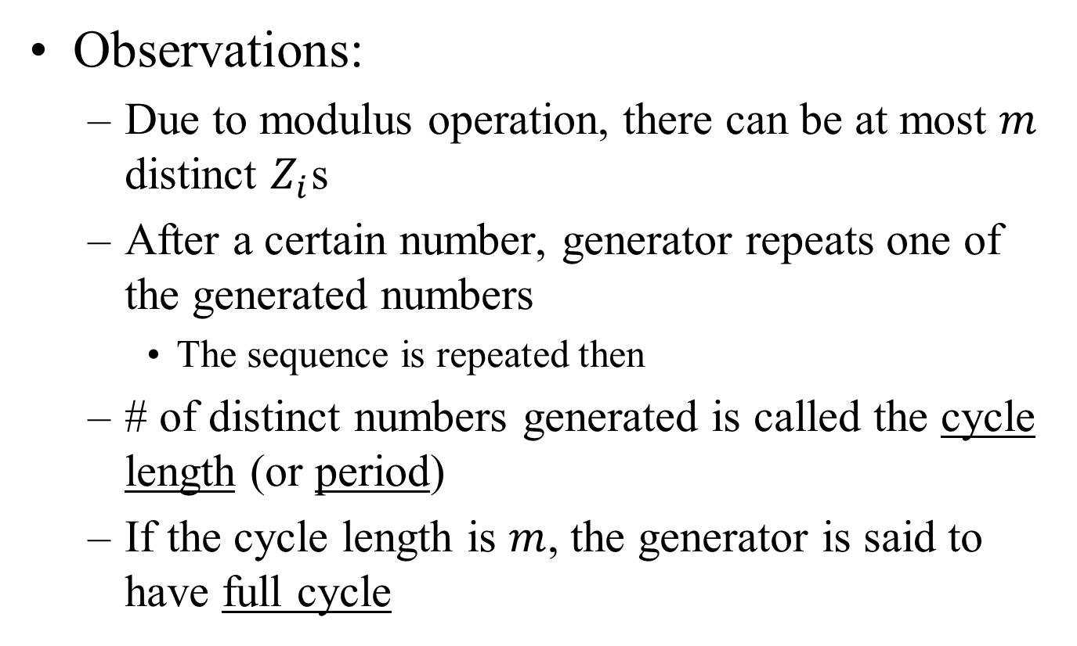
LCG – Example
Observations:
Due to modulus operation, there can be at most $m$ distinct $Z_{i}$s
After a certain number, generator repeats one of the generated numbers
The sequence is repeated then
# of distinct numbers generated is called the cycle length (or period)
If the cycle length is $m$, the generator is said to have full cycle

Slide 14
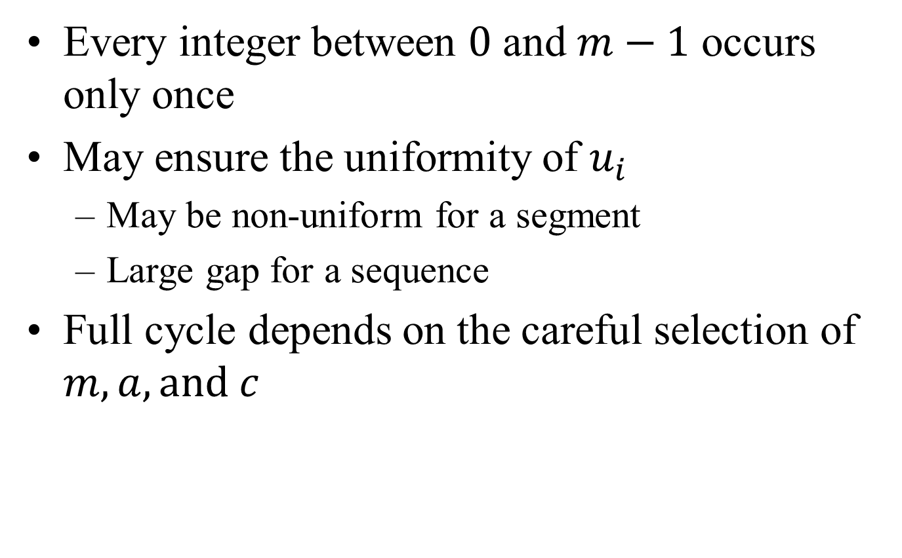
Properties of Full Cycle Generators
Every integer between $0$ and $m−1$ occurs only once
May ensure the uniformity of $u_{i}$
May be non-uniform for a segment
Large gap for a sequence
Full cycle depends on the careful selection of $m, a, and c$

Slide 15
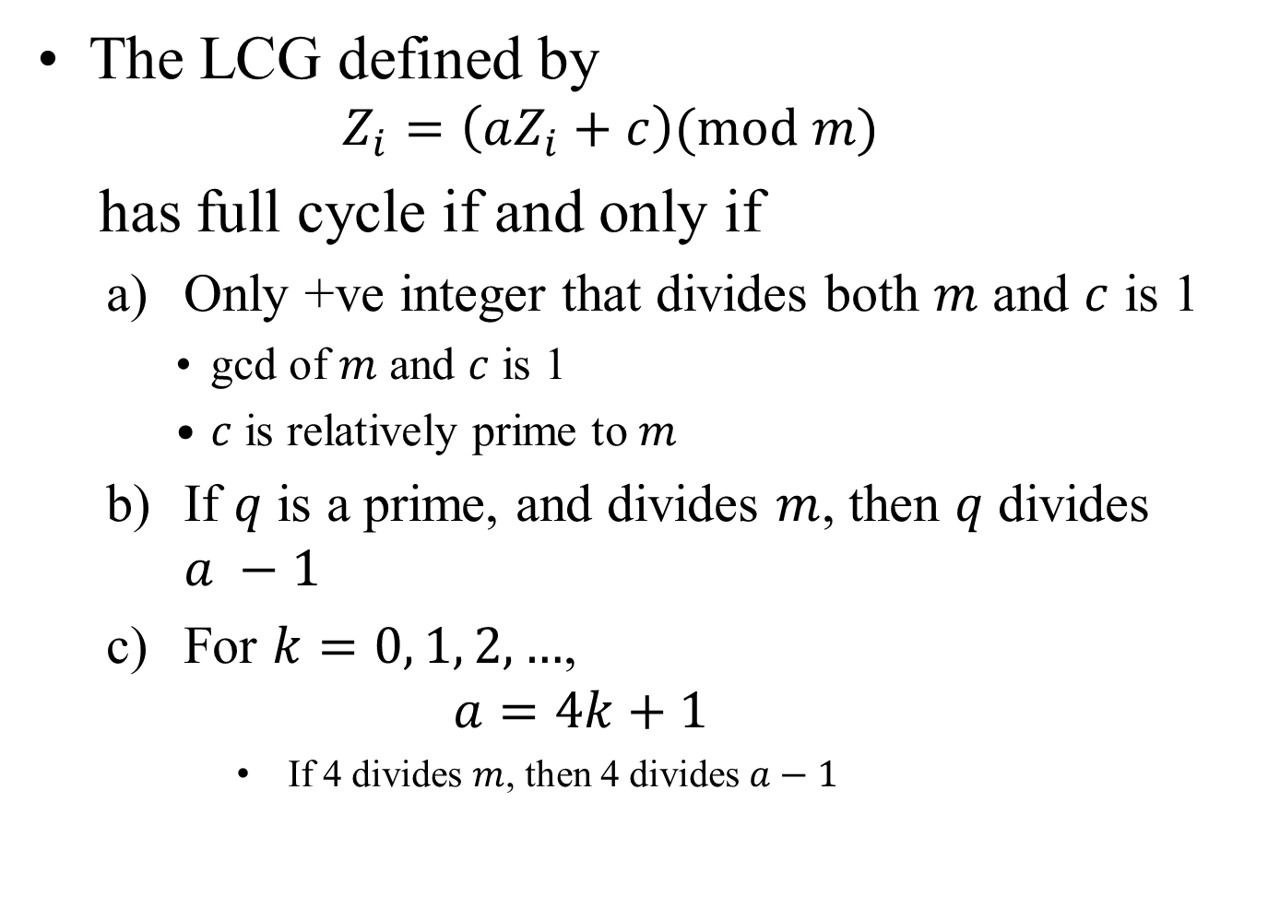
Theorem: Full Cycle LCG
The LCG defined by
$$Z_{i}=\left(aZ_{i}+c\right)(mod m)$$
has full cycle if and only if
Only +ve integer that divides both $m$ and $c$ is 1
gcd of $m$ and $c$ is 1
$c$ is relatively prime to $m$
If $q$ is a prime, and divides $m$, then $q$ divides $a −1$
For $k=0, 1, 2, …$,
$$a=4k+1$$
If 4 divides $m$, then 4 divides $a−1$

Slide 16
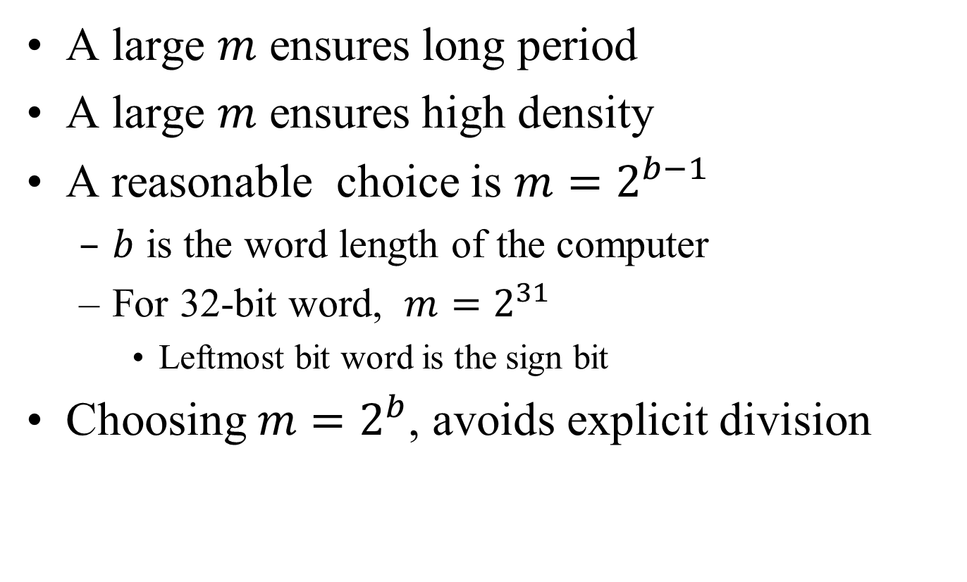

LCG: Choice of $m$ (1/2)
A large $m$ ensures long period
A large $m$ ensures high density
A reasonable choice is $m=2^{b−1}$
$b$ is the word length of the computer
For 32-bit word, $m=2^{31}$
Leftmost bit word is the sign bit
Choosing $m=2^{b}$, avoids explicit division

Slide 17
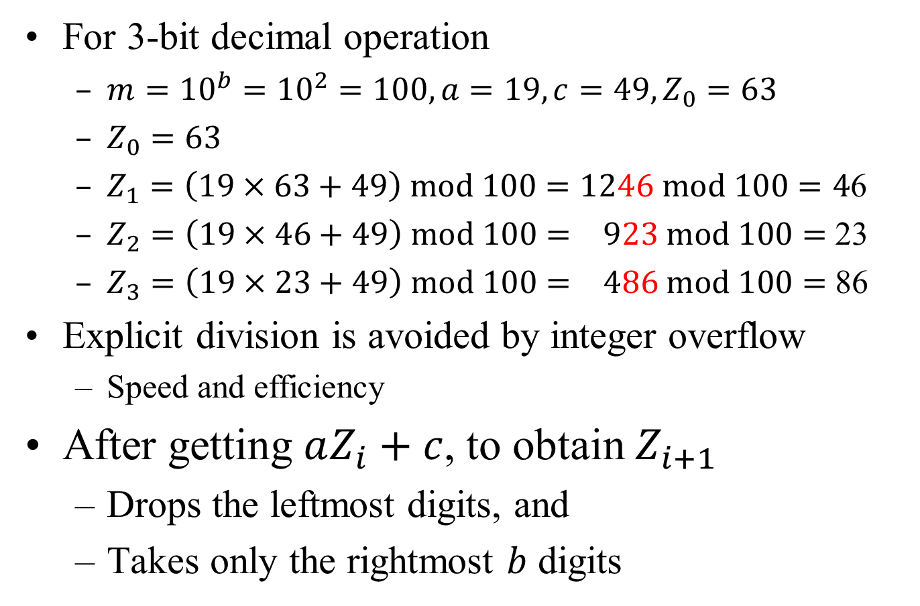

LCG: Choice of $m$(2/2)
For 3-bit decimal operation
$m={10}^{b}={10}^{2}=100, a=19, c=49, Z_{0}=63$
$Z_{0}=63$
$Z_{1}=\left(19×63+49\right) mod 100=1246 mod 100=4$6
$Z_{2}=\left(19×46+49\right) mod 100= 923 mod 100=$ 23
$Z_{3}=\left(19×23+49\right) mod 100= 486 mod 100=$86
Explicit division is avoided by integer overflow
Speed and efficiency
After getting $aZ_{i}+c$, to obtain $Z_{i+1}$
Drops the leftmost digits, and
Takes only the rightmost $b$ digits

Slide 18
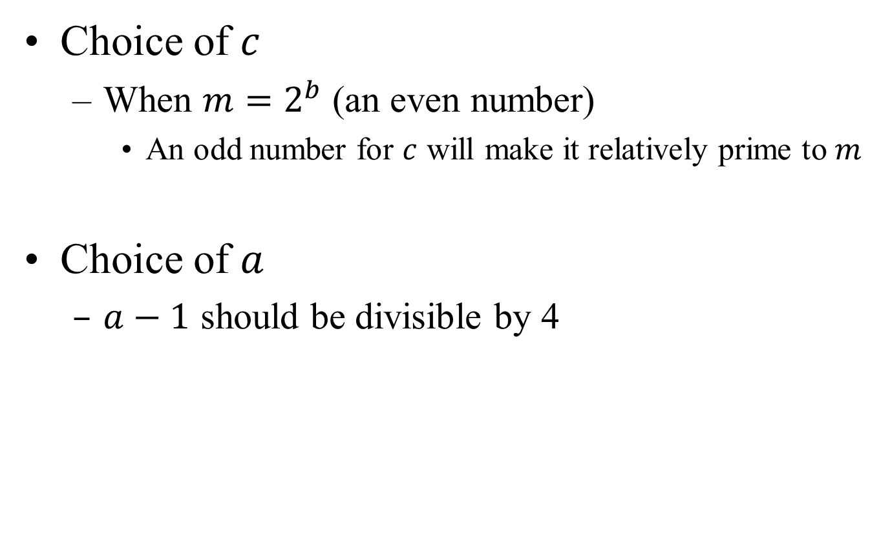

LCG: Choice of $c$ and $a$
Choice of $c$
When $m=2^{b}$ (an even number)
An odd number for $c$ will make it relatively prime to $m$
Choice of $a$
$a−1$ should be divisible by 4

Slide 19
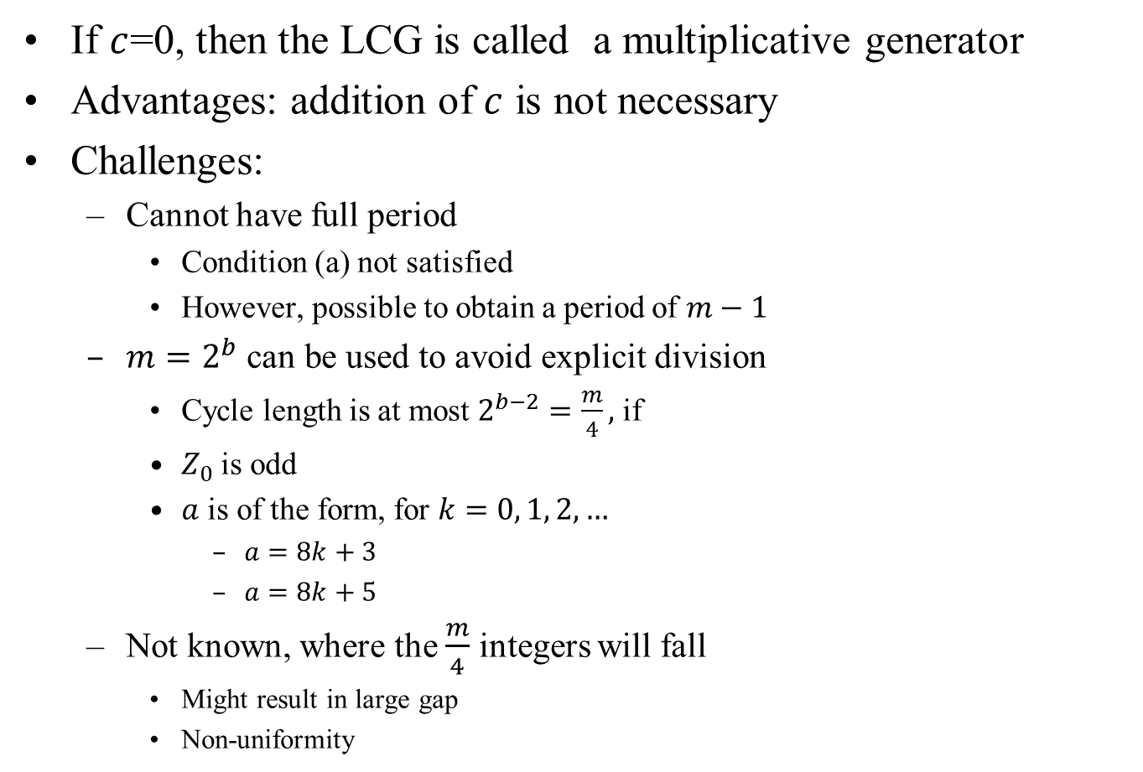
Multiplicative Generator
If $c$=0, then the LCG is called a multiplicative generator
Advantages: addition of $c$ is not necessary
Challenges:
Cannot have full period
Condition (a) not satisfied
However, possible to obtain a period of $m−1$
$m=2^{b}$ can be used to avoid explicit division
Cycle length is at most $2^{b−2}=\frac{m}{4},$if
$Z_{0}$ is odd
$a$ is of the form, for $k=0, 1, 2, …$
$a=8k+3$
$a=8k+5$
Not known, where the $\frac{m}{4}$ integers will fall
Might result in large gap
Non-uniformity

Slide 20
Multiplicative LCG
i | z_{i} | z_{i} | z_{i} | z_{i}
0 | 1 | 2 | 3 | 4
1 | 13 | 26 | 39 | 52
2 | 41 | 18 | 59 | 36
3 | 21 | 42 | 63 | 20
4 | 17 | 34 | 51 | 4
5 | 29 | 58 | 23
6 | 57 | 50 | 43
7 | 37 | 10 | 47
8 | 33 | 2 | 35
9 | 45 |  | 7
10 | 9 |  | 27
11 | 53 |  | 31
12 | 49 |  | 19
13 | 61 |  | 55
14 | 25 |  | 11
15 | 5 |  | 15
16 | 1 |  | 3
a = 13
m = 2^{b} = 64
Z₀=1,2,3,4

Slide 21
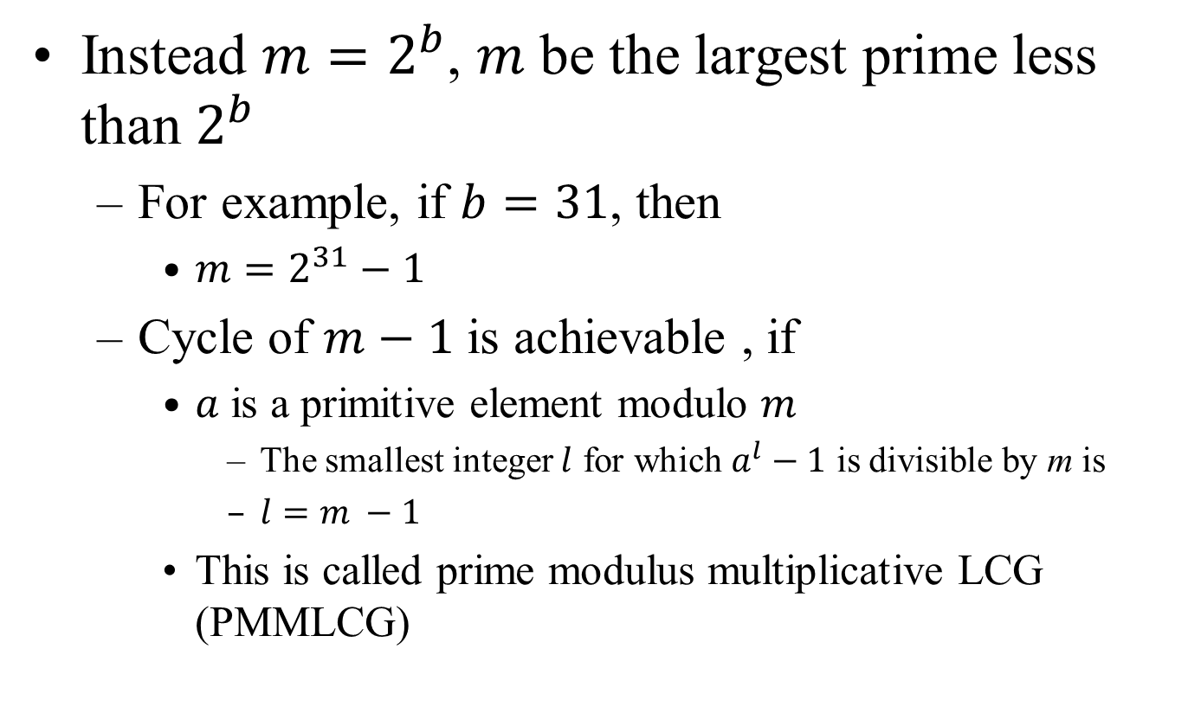
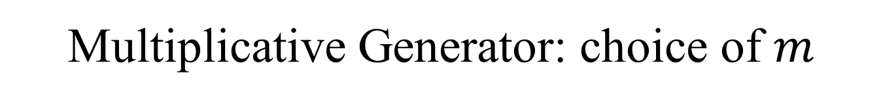
Multiplicative Generator: choice of $m$
Instead $m=2^{b}$, $m$ be the largest prime less than $2^{b}$
For example, if $b=31$, then
$m=2^{31}−1$
Cycle of $m−1$ is achievable , if
$a$ is a primitive element modulo $m$
The smallest integer $l$ for which $a^{l}−1$ is divisible by m is
$l=m −1$
This is called prime modulus multiplicative LCG (PMMLCG)

Slide 22

Challenges with PMMLCG
How can one obtain primitive element modulo $m$?
Since $m≠2^{b}$, how can we avoid the division operation?

Slide 23
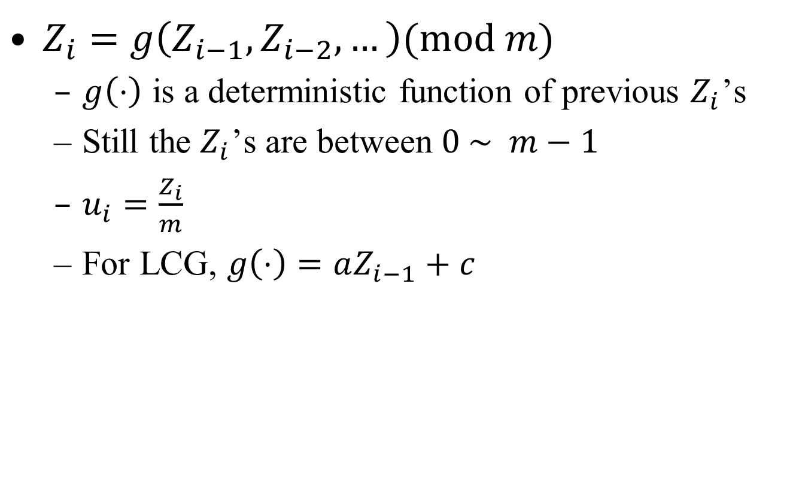
More General Congruence
$Z_{i}=g\left(Z_{i−1}, Z_{i−2}, …\right)(mod m)$
$g\left(⋅\right)$ is a deterministic function of previous $Z_{i}$’s
Still the $Z_{i}$’s are between $0 \sim m−1$
$u_{i}=\frac{Z_{i}}{m}$
For LCG, $g\left(⋅\right)=aZ_{i−1}+c$

Slide 24

Quadratic Congruential Generator
$g\left(⋅\right)=a^{′}Z_{i−1}^{2}+aZ_{i−1}+c$

Slide 25

Multiple recursive Generator
$g\left(⋅\right)=a_{1}Z_{i−1}+a_{2}Z_{i−2}+⋯+a_{q}Z_{i−q}$
Cycle is as large as $m^{q}−1$

Slide 26
Composite Generator
Takes two or more separate generators
Combine them to generator the final random number
Expected to exhibit a longer cycle and better statistical properties

